Slide 1

Problem Statement and Team Details
Problem Statement: Smart Doc Checker
Team Name: OptiMind
Team Leader Name: Sri Hansika Saraf
Institute Name: Koneru Lakshmaiah Education foundation,Bachupally
Team Leader Email ID: 2420030556@klh.edu.in

Slide 2
Problem and Solution
Problem
Multiple documents (rules, policies, contracts) often contradict each other.
Manual checking is boring, slow, and error-prone.
Leads to confusion, disputes, and penalties.
Solution
Smart Doc Checker Agent to scan and compare docs.
Flags contradictions & overlaps automatically.
Generates a clear report of issues.
Integrated with Flexprice (billing) and Pathway (live updates).

Slide 3
Methodology & Implementation
File Upload : Users upload 2–3 docs (CSV/TXT/PDF) via portal.
Conflict Detection : Text is parsed, regex + rule-based AI checks for mismatched numbers, timelines, rules.
Explanations : Each flagged conflict shown with a simple human-readable reason.
Report Generation : Auto-create PDF report listing contradictions.
Usage Counter (Flexprice) : Track docs checked & reports made; bill per use.
Pathway Integration : Mock external policy update triggers auto re-check.
UI Output :Clear web interface highlighting conflicts & usage stats.

Slide 4
Technology Used
Streamlit : Interactive UI (uploads, reports)
Python 3.10+ with NLTK & Regex: Text processing
Sentence-Transformers: Semantic similarity
pdfplumber / python-docx: PDF & Word parsing
Flexprice (billing simulation)
Pathway (mock external updates)
Tools: Virtualenv, pip, PyCharm/VS Code

Slide 5
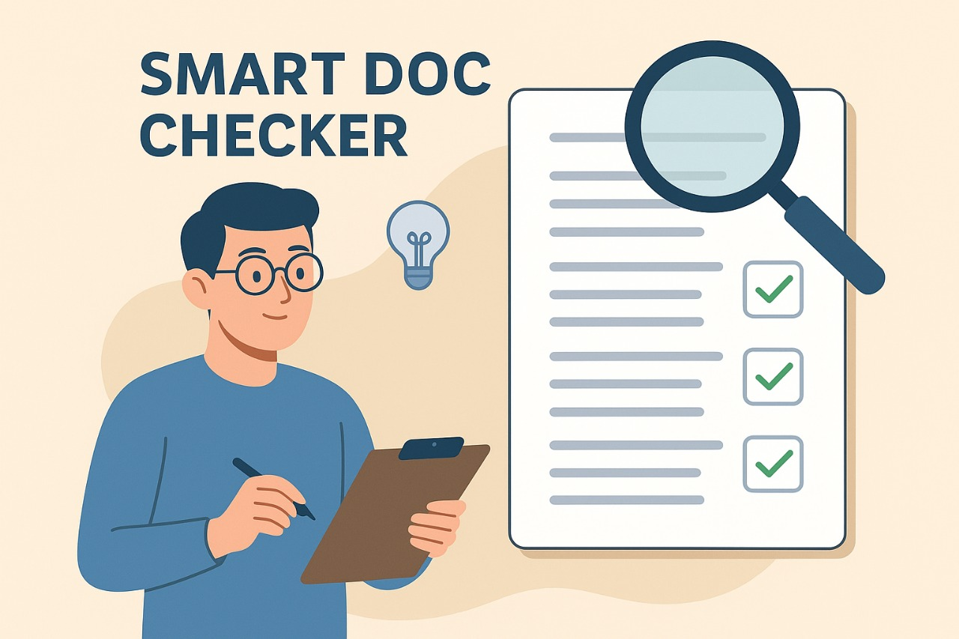
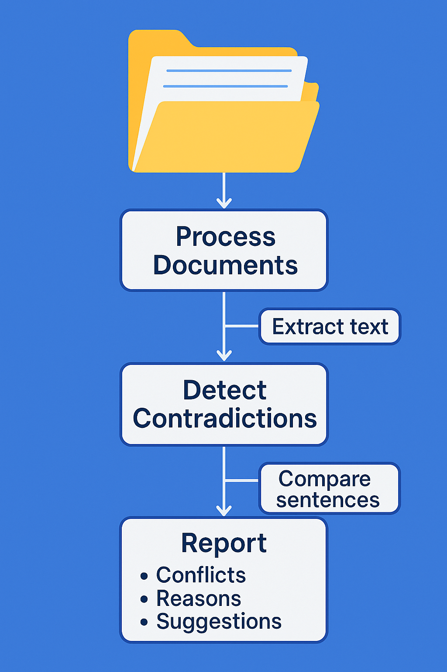
Flowchart & Supporting Images
Supporting Images

Slide 6
Feasibility and Market Use
Feasibility
Technical: Uses existing NLP models, easy to prototype with Streamlit, scalable later with Flask/FastAPI.
Operational: Simple UI (upload → analyze → report), fits into portals/workflows.
Economic: Low-cost (open-source tools), cloud deployable, revenue via per-doc/report billing.
Market Use
Corporate: HR & Legal teams → check contradictions in contracts, policies, handbooks.
Education: Colleges/Universities → detect mismatches in rules, circulars, syllabus.
Startups/SMEs: Validate contracts, NDAs, MoUs quickly.
Government/NGOs: Monitor policies/circulars for consistency, reduce disputes.

Slide 7
Conclusion
Addresses the problem of conflicting rules, policies, and contracts that cause confusion and disputes.
Provides an AI-driven solution that scans documents, highlights contradictions, and suggests clarifications.
Incorporates Flexprice for billing and Pathway for monitoring external updates.
Technically feasible with open-source NLP models, Streamlit interface, and scalable deployment options.
Strong market potential across corporates, educational institutions, startups, and government sectors.
Delivers clear value by saving time, reducing errors, minimizing risks, and enabling cost-effective compliance management.

